Slide 1
Project1 Image processing: “Cluster Finding” Group A：Zheming Xu, Taixi Xia, Xin Zhang
Notes:
We are group A. I will do the first half of our presentation and Xia Taixi will do the second half.

Slide 2
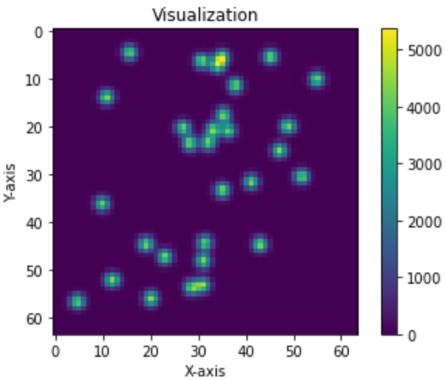
Background
“Cluster Finding" in image processing
Develop algorithms to identify "clusters
Notes:
Let’s begin with background.Project 1 focuses on the issue of "cluster finding" in image processing. The main goal of this project is to develop algorithms to identify "clusters" or groups in 2D images. These images can come from various scientific experiments or applications, such as collision data in particle physics, star clusters in astronomical images, etc.

Slide 3
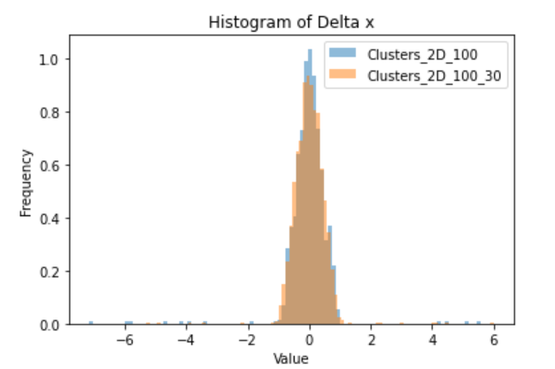
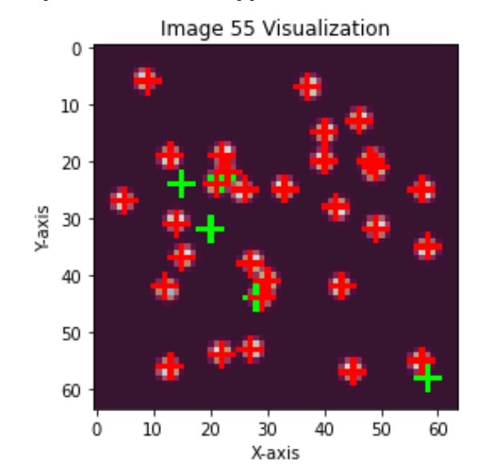
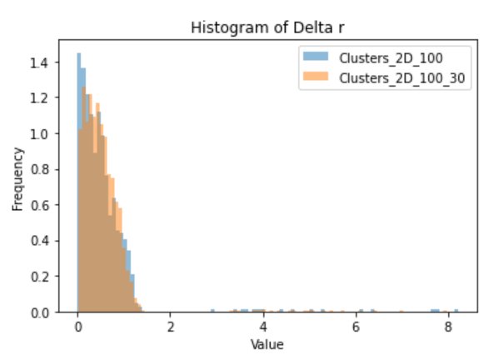
Local Maximum Finding Algorithm: A Simple Approach
Notes:
We use the simplest local maximum algorithm and weighted average method to find the center of clusters. First one is that find local maxima, which means that compare each number to the values in the 3 by 3 matrix around it to find all local maxima.
And next is clustering. For each non-zero value in the matrix, find the local maximum closest to it and group them together
The third step is to calculate weighted average, just calculate center of gravity for each group of these clusters.
This method can handle individual points well, but the processing effect is poor when two or more points overlap. It may only be able to find one point and is sensitive to noise in the image. The error shown on the right is that dx has an error of 6 pixels, which is due to the local maximum algorithm finding the noise.

Slide 4
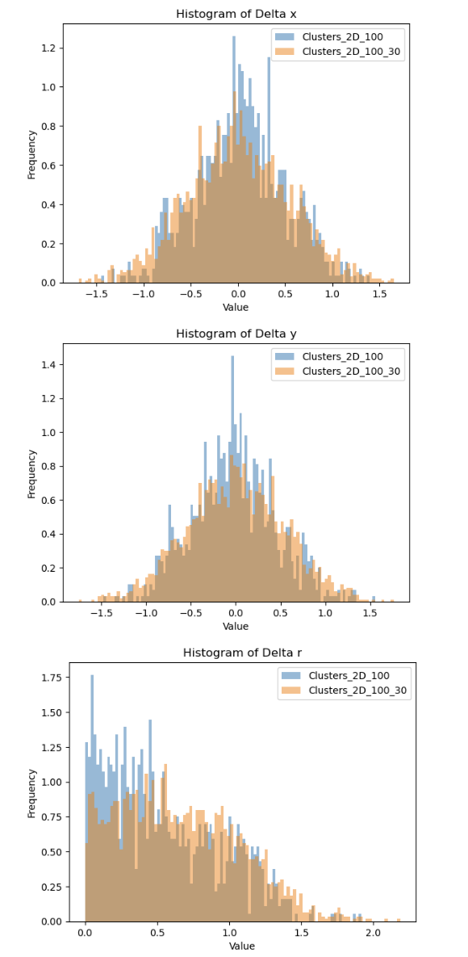
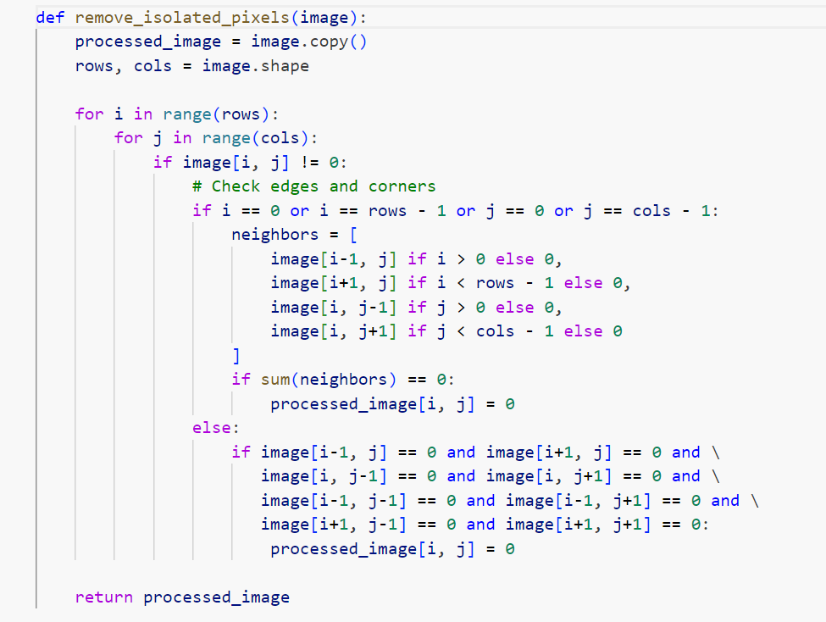
For Isolated Noise：
Notes:
Then, we perform a simple denoising: For a non-zero value, if the 3 by 3 matrix around it is 0, it will be set to 0 in order to remove isolated noise. The effect after denoising is shown in the figure, and it can be seen that the error has been reduced a lot.

Slide 5
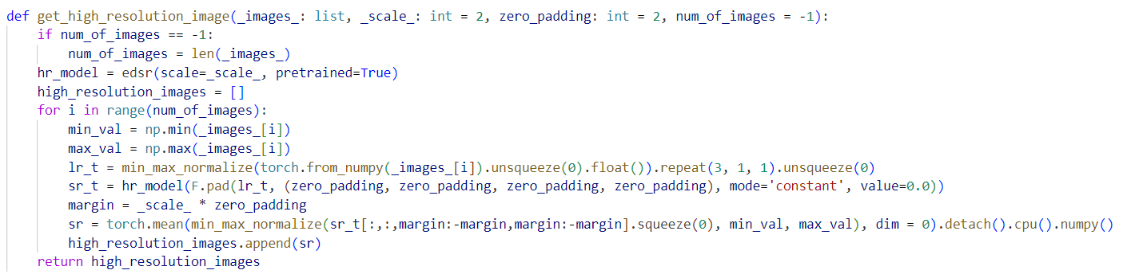
For Overlapping Points：EDSR Model
EDSR uses multiple convolutional layers to extract features from images. Convolutional layers apply filters to the input image, allowing the network to learn spatial hierarchies of features.
Reference: https://github.com/Coloquinte/torchSR
Notes:
For overlapping points, we use the EDSR model to improve the image resolution: EDSR is an advanced algorithm designed to convert low-resolution images into high-resolution ones. It uses a very deep convolutional neural network and residual blocks to capture more image details, while removing batch normalization layers to improve image quality. EDSR excels at handling image details and recovering high-quality images, and is widely used in various image processing tasks. First, we need to load a pre-trained EDSR model. This model has been optimized through extensive training data and is capable of effectively enhancing image resolution.
Next, we preprocess the input low-resolution image by normalizing its pixel values to the range [0, 1]. This step helps to improve the stability and performance of the model.
After normalization, we feed the image into the EDSR model for super-resolution reconstruction. During this process, we also add zero padding to the edges of the image to ensure the reconstructed image maintains consistent dimensions.
Finally, we remove the zero padding added in the previous step. Then, we restore the reconstructed image from the normalized [0, 1] range to the original pixel value range. This gives us a high-resolution image that is consistent with the original image.

Slide 6
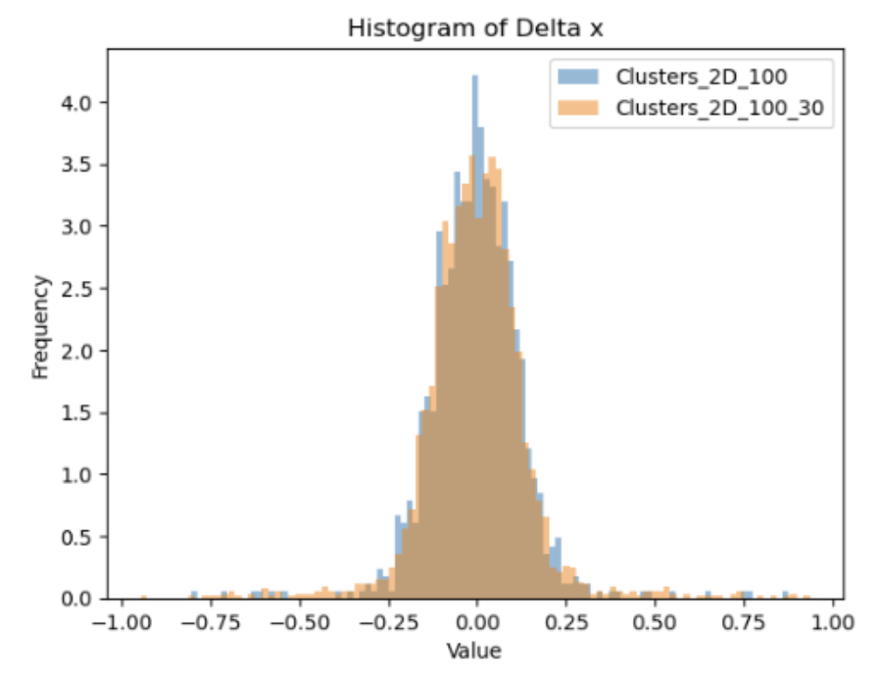
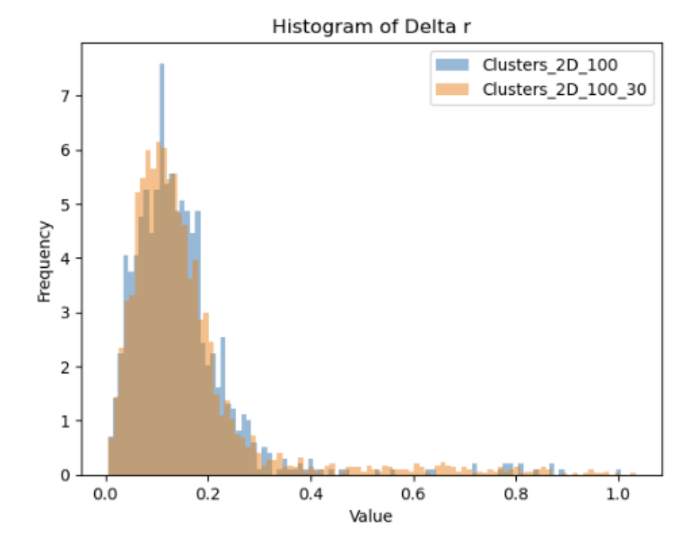
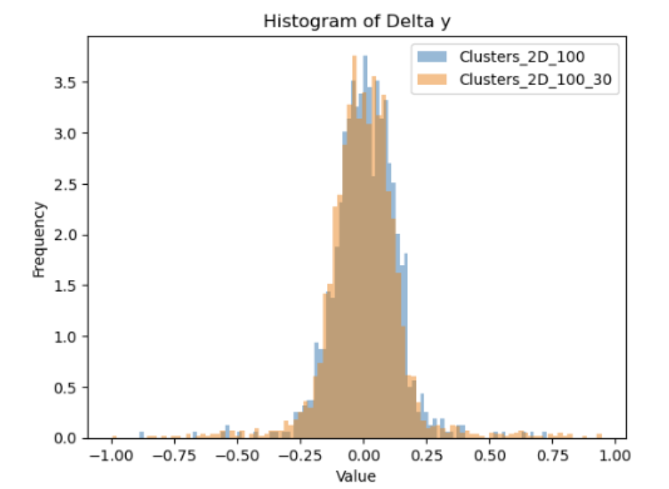
For overlapping points：EDSR model
Notes:
The improved effect is shown in the figure. And next half will be given by Xia Taixi.

Slide 7
Next Step: Higher Resolution, Higher Identification Ratio
Try and find the most suitable neighborhood areas to calculate “center of mass” to optimize the result.
For those clusters which were failed to be recognized, we can use a weaker creteria. This approach may introduce many noise clusters, so we need to weed them out.
For those noise clusters, we can apply a threshold to the raw image, or use chracteristics such as the value of the maxima, sum of 3*3 neighborhood, sum of 5*5 neighborhood
Notes:
The improved effect is shown in the figure. And next half will be given by Xia Taixi.

